Slide 1
Modern Control Theory
Model Predictive Control - MPC – Lecture 2
Dynamic Prediction Models

Slide 2
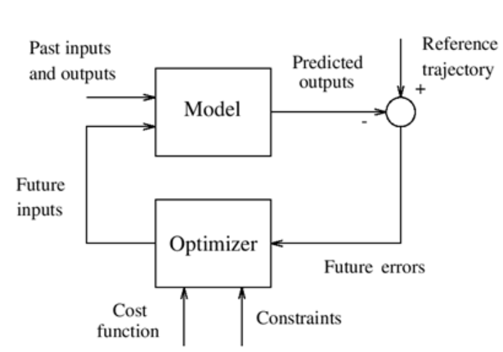
RECAP
Second definition of MPC:
MPC is a controller which uses prediction that includes the effect of past and future control actions such that to satisfy the desired objectives without violation of constraints but implements only the first time-step action at EVERY TIME STEP.
KEY ELEMENTS OF MPC
Prediction Model
Effect of past actions onto the future (implemented)
Effect of current and future actions (to be implemented)
Objectives with Constraints to be met on Input action, Output deviations
Optimizer to obtain the control actions
Implementing the first step and re-computing the control trajectory at each time step is called Receding Horizon control

Slide 3
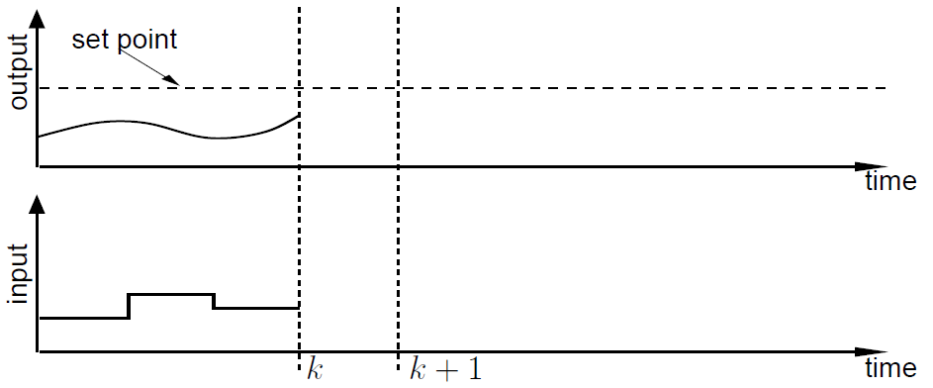
Receding Horizon Control

Slide 4
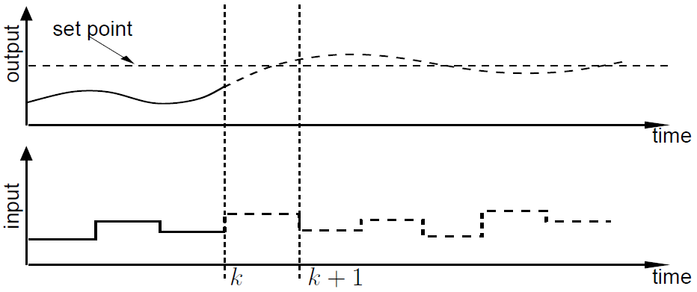
Receding Horizon Control

Slide 5
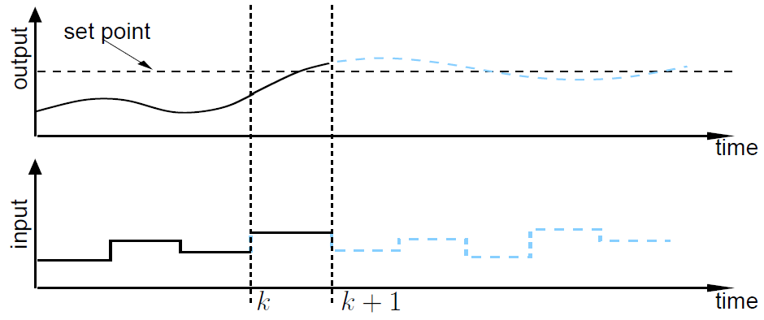
Receding Horizon Control

Slide 6
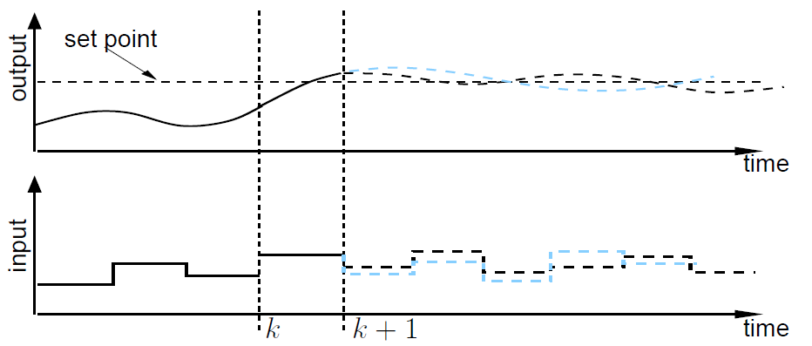
Receding Horizon Control

Slide 7
Receding Horizon Control/ MPC
Implementation steps ONLINE
Obtain the current measurements of states
Compute the optimal finite horizon control sequence (u_{k}, u_{k+1}, …u_{M})
Implement first move u_{k}
Repeat from Step 1
What are offline activities for a MPC controller?
Past inputs
MPC Controller
at each time step (k)
Current measurements
u_{k}, u_{k+1}, …u_{M}
Identifying a model – system identification – 60-70% of effort
Identifying the objectives and cost function
Tuning
past measurements
Model
Objectives
Constraints
Tuning

Slide 8
Prediction models in MPC

Slide 9
Dynamic prediction models
Model types
Physics/ first principles based
Data-based (or empirical) models
Input/ Output Relationships
Linear (L) or
non-linear (NL)
Types of LINEAR models
Impulse response coefficients (Linear, Stable, data based)
Step response coefficients – Large industry adoption (Linear, Stable, data based)
State-space – Recent applications such autonomous vehicles, robots, satellite systems (Linear, Non-linear, Stable/ Unstable, physics and data based)

Slide 10
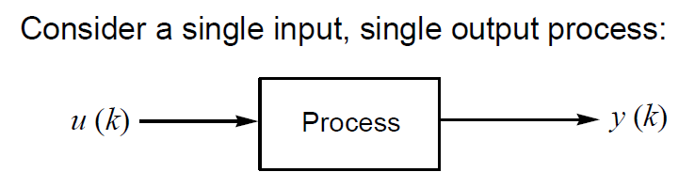
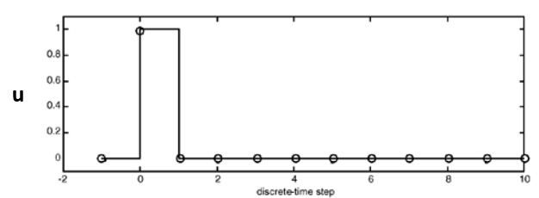
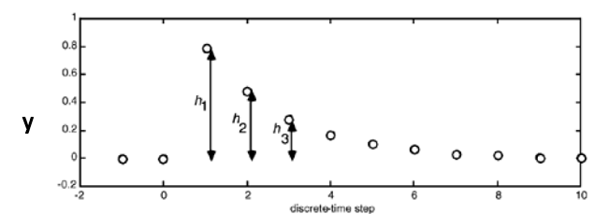
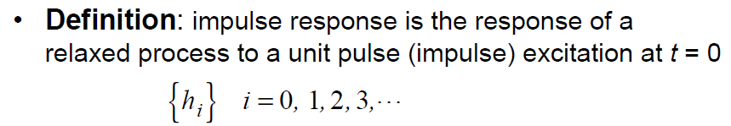
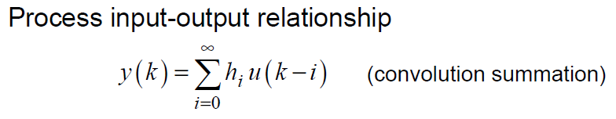
Discrete impulse response models

Slide 11
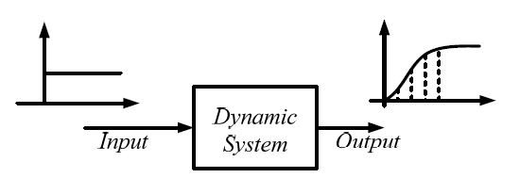
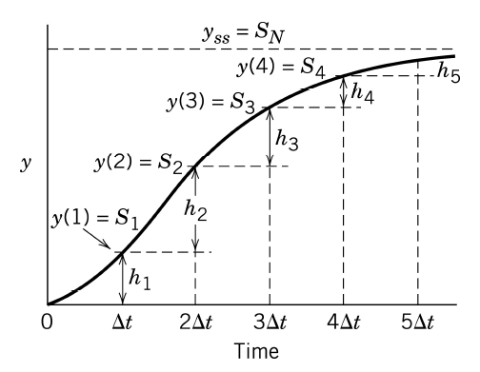



Step Response models (1/4)
Why are step responses popular?
Δu_{k} = u_{k} – u_{k-1}
u_{k-1} = 0
u_{k} = 1
y₁ = y₀ + S₁Δu₀
y₂ = y₀ + S₂Δu₀ . .
.
y_{n} = y₀ + S_{n}Δu₀
For a unit step u_{k} = 1 for all k

Slide 12
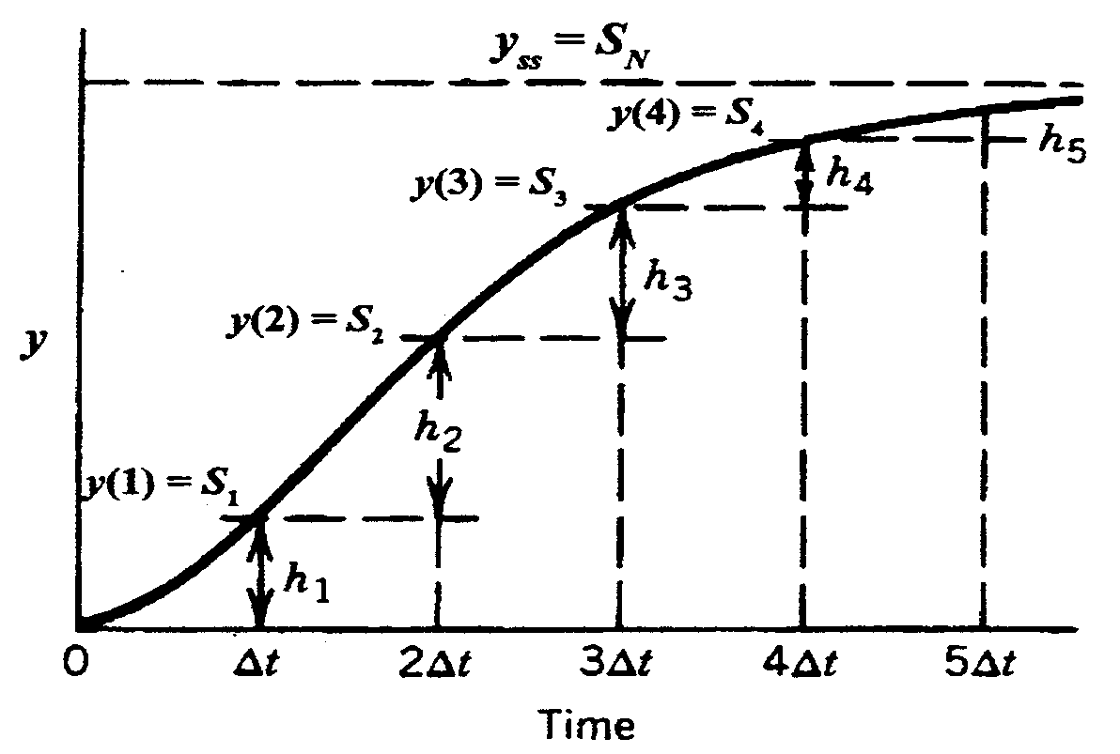
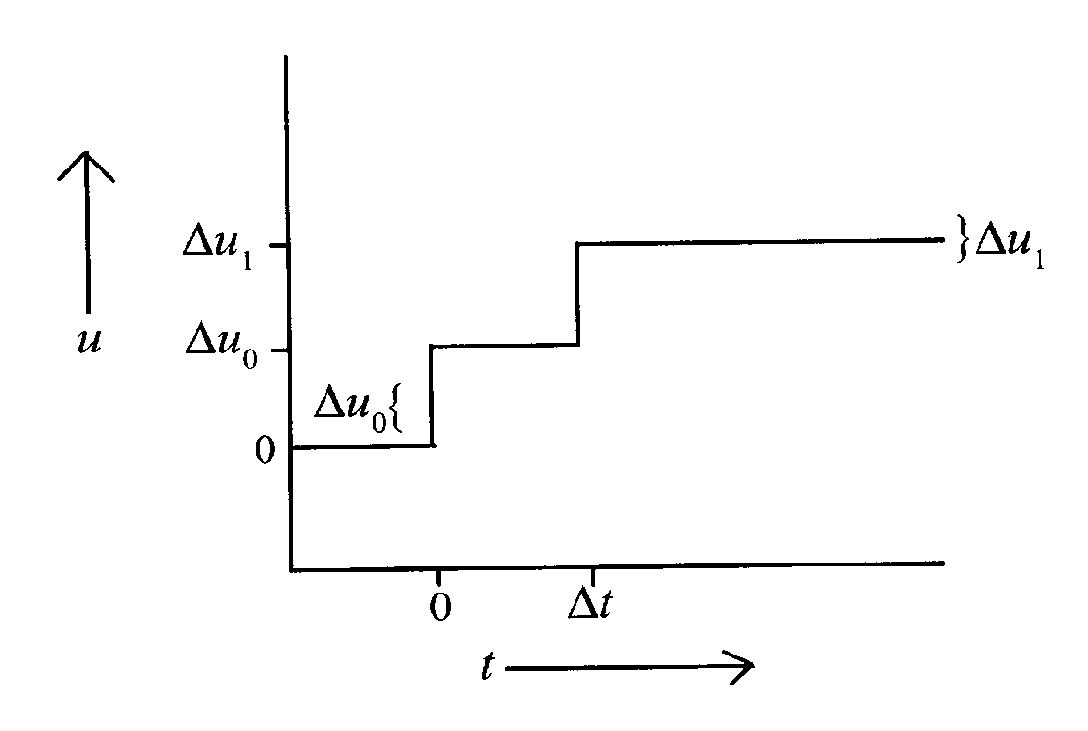

Step response predictions (2/4)
From the Principle of Superposition for linear systems:
y₁ = y₀ + S₁Δu₀
y₂ = y₀ + S₂Δu₀ + S₁Δu₁
y₃ = y₀ + S₃Δu₀ + S₂Δu₁
. .
. .
y_{N} = y₀ + S_{N}Δu₀ + S_{N-1}Δu₁
Can extend also to MIMO Systems as simple Multi input Single output (MISO) systems

Slide 13
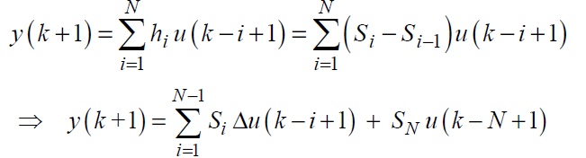
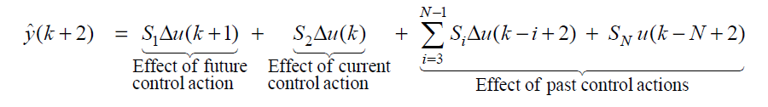
Step response predictions (3/4)
S^{i} = i^{th} step response coefficient
Δuk = u(k) – u(k-1)
N = prediction window or horizon
One step ahead prediction
Two step ahead prediction

Slide 14
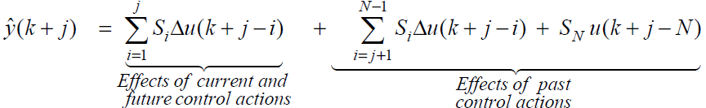
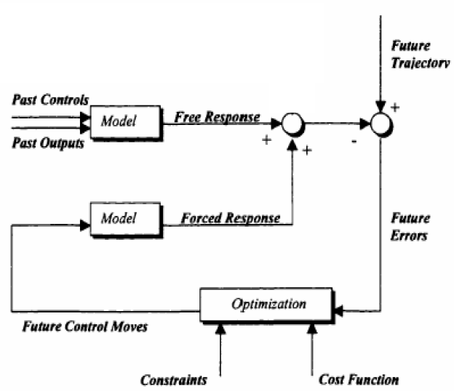


Step response prediction (4/4)
j^{th} step ahead prediction
What happens when u(k-i) = u(k-1) for all i > 0
Predicted FREE response
=

Slide 15
Example – simple predictive receding horizon controller
Find a predictive control law with single receding horizon move, such that
j^{th} step ahead prediction
Given
j = J,
Δu(k + i) = 0 for i > 0, i.e. Δu(k + 1) = Δu(k + 2) …. = Δu(k + J-1) = 0
Free response
Forced response
SISO system with prediction-based control law using simple step response coefficients
y_{sp} =
What are the pitfalls in this?

Slide 16
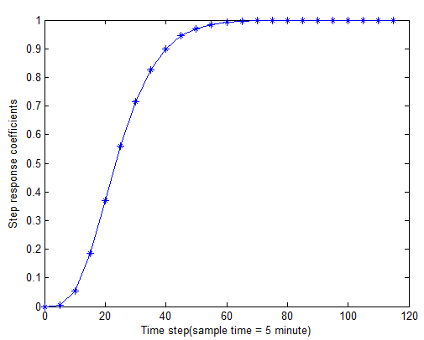
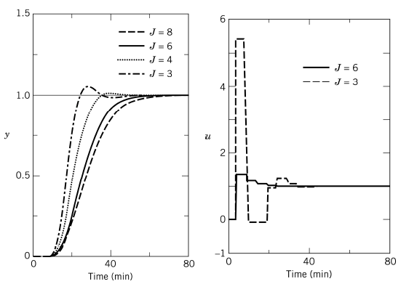
Example – simple predictive receding horizon controller
J = 3, 4, 6, 8
Δt = 5 mins
As J increases Sj increases
The move required tend to be smaller as J increases
As J decreases, y becomes aggressive

Slide 17
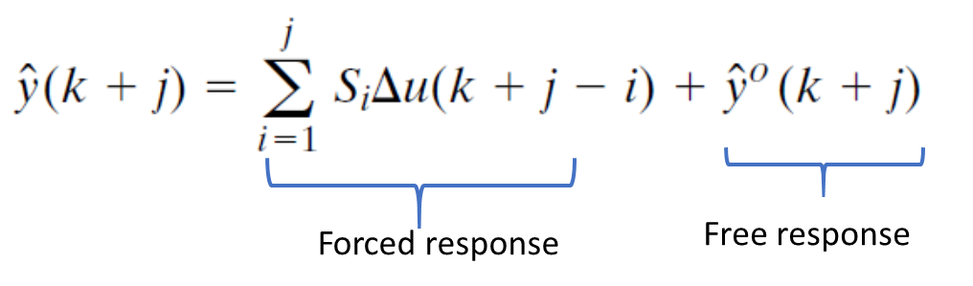
Multi input Multi output prediction models - step response (1/2)
=
+
S_{j}
S_{j-1}
S₁
Δu(k + j-1)

Slide 18
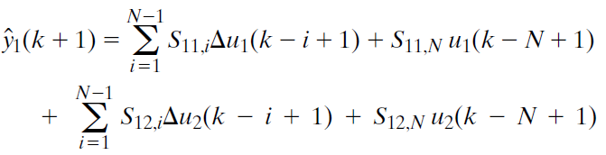
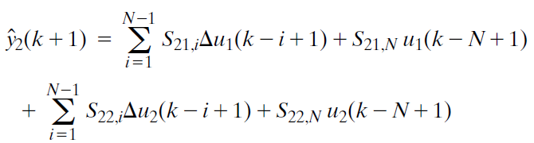
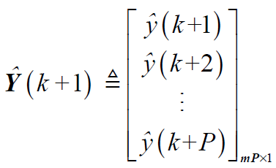
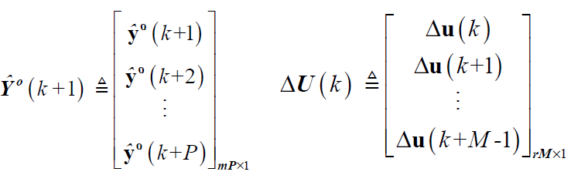


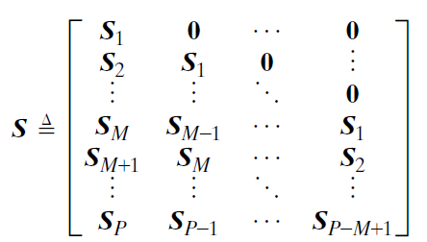

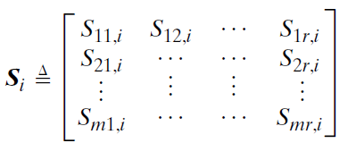
Multi input Multi output prediction models - step response (2/2)
Principle of superposition: Example 2 inputs and 2 outputs
P step ahead predictions for M future control moves
‘r’ inputs
‘m’ outputs
Forced
response
Free
response

